Slide 1


Name of Project :-
SMART IRRIGATION – AICTE Internship (Cycle-2)

Slide 2

LEARNING OBJECTIVES
🔍 Explore AI in Agriculture :-
Understand how AI improves efficiency in irrigation and crop management through automation.
💡 Preprocess Sensor Data :-
Clean and scale real-world data (e.g., moisture, temperature) using techniques like MinMax scaling.
🧠 Implement Multi-Output Classification :-
Train a model to predict sprinkler status for multiple zones using Random Forest with MultiOutputClassifier.
🖥️ Deploy an Interactive Web App :-
Use Streamlit to build a user-friendly interface for real-time predictions based on sensor inputs.
📈 Enable Smart Irrigation Decisions :-
Support farmers with precise, data-driven recommendations to optimize water use and crop health.
GOAL

Slide 3
TOOLS AND TECHNOLOGY USED
🔧 CATEGORY | 🧩 TOOLS / LIBRARIES
🖥️ Language | Python 3
📊 Data Manipulation | Pandas, NumPy
🤖 ML Modeling | Scikit-learn, MultiOutputClassifier
🧼 Data Preprocessing | MinMaxScaler
🚀 Deployment | Streamlit, Joblib
📈 Visualization | Matplotlib, Seaborn
🧪 Model Evaluation | classification_report, accuracy_score
🧠 Algorithm | RandomForestClassifier
📝 IDE/Notebook | Jupyter Notebook, VS Code
📦 File Formats | CSV (dataset), PKL (model)
🌐 Web Framework (UI) | Streamlit Sliders, Streamlit Buttons
🔗 Version Control | Git, GitHub
📤 Model Export | Joblib

Slide 4

METHODOLOGY
1️⃣ Data Collection 📁
Used irrigation_machine.csv
20 input features (sensor readings)
20 output labels (sprinkler ON/OFF)
Data simulated or collected from field sensors
2️⃣ Data Cleaning & Preprocessing 🧹
Removed nulls/missing values
Normalized inputs using MinMaxScaler (0–1)
Split into 80% training and 20% testing
3️⃣ Model Selection 🤖
Chose RandomForestClassifier for accuracy and robustness
Used MultiOutputClassifier for 20 simultaneous predictions
Suitable for multi-label binary output
4️⃣ Model Training 📊
Trained model on scaled input data
Learned mapping from sensor inputs → sprinkler decisions
Fine-tuned parameters for better generalization

Slide 5
METHODOLOGY
5️⃣ Model Evaluation 🧪
Metrics: Accuracy, Precision, Recall, F1-score
Used classification_report from sklearn
Verified balanced prediction across all zones
6️⃣ Model Export 💾
Saved trained model as Farm_Irrigation_ System.pkl
Used joblib for serialization
Enables reuse without retraining
7️⃣ Web App Development 🖥️
Built with Streamlit
20 sliders to input sensor values (0–1)
One-click prediction with real-time output display
8️⃣ Local Deployment & Testing 🌐
Launched using streamlit run app.py
Tested with various sensor combinations
Verified output readability and model behavior

Slide 6
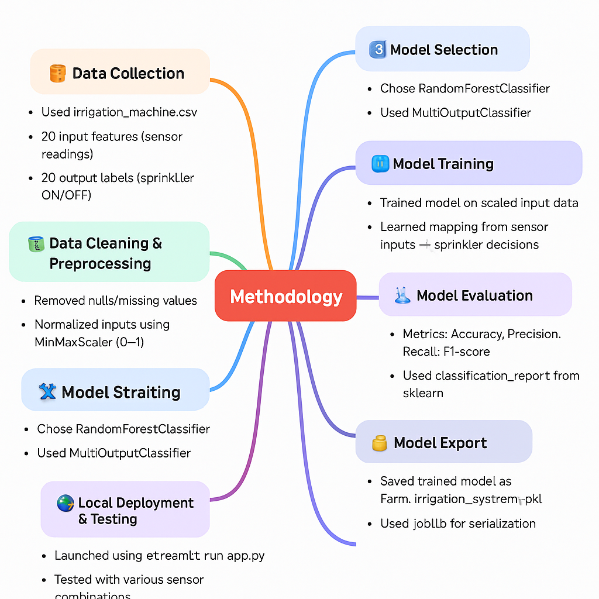

Slide 7
PROBLEM STATEMENT:
🌾 Challenges in Traditional Irrigation Systems :-
Agriculture, the backbone of many economies, still relies heavily on outdated irrigation practices. Most traditional systems use manual controls or fixed schedules for water distribution, without accounting for real-time environmental and soil conditions. This leads to a number of serious issues:
🔴 Key Problems Identified :-
🌊 Water Wastage
Over-irrigation due to lack of automation wastes vast amounts of water, especially in drought-prone areas.
🌱 Crop Stress and Reduced Yield
Inconsistent watering can cause stress to crops, resulting in poor growth, diseases, and low productivity.
⏱️ High Labor Dependency
Manual irrigation requires continuous monitoring and intervention, increasing human effort and operational costs.
📉 No Real-Time Decision-Making
Without data-driven insights, decisions are guesswork-based, ignoring vital sensor metrics like soil moisture, temperature, or humidity.
🧠 Lack of Smart Integration
Most systems lack AI-enabled logic to make adaptive and zone-specific irrigation decisions

Slide 8
SOLUTION:
To solve the inefficiencies in traditional irrigation methods, we introduce a Smart Irrigation System that integrates AI, sensor data, and a web-based user interface to make precise, real-time irrigation decisions.
🔧 Solution Components:-
📥 1. Real-Time Sensor Input Interface :
Users input 20 real-time sensor readings (e.g., soil moisture, temperature, humidity).
Inputs are scaled between 0 and 1 using MinMaxScaler.
Data input via interactive Streamlit sliders.
🧠 2. Machine Learning Model (Smart Brain) :
A RandomForestClassifier wrapped in a MultiOutputClassifier.
Trained to predict the ON/OFF status of 20 sprinkler zones.
Learns the relationship between sensor patterns and optimal irrigation behavior.
Ensures multi-label prediction in one go.
🛠️ 3. Efficient Deployment with Streamlit :
Created a user-friendly web application using Streamlit.
Allows users (e.g., farmers or technicians) to interact with the model through a GUI.
Shows immediate sprinkler decisions based on input.
Provides local, lightweight, real-time results.

Slide 9
SOLUTION:
💾 4. Model Reusability (No Need to Retrain) :
Model saved as Farm_Irrigation_System.pkl using joblib.
Can be reused anytime without retraining.
Enables fast loading and execution.
🌿 5. Zone-wise Intelligent Irrigation :
System enables individual control over each sprinkler.
Helps reduce water waste and manual effort.
Provides customized irrigation decisions per zone based on sensor values.
📈 6. Scalable & Sustainable :
Easily extendable to integrate with real-world IoT sensor networks.
Can include weather APIs, soil type adaptations, and crop-specific models.
Supports sustainable agriculture through data-driven automation.

Slide 10
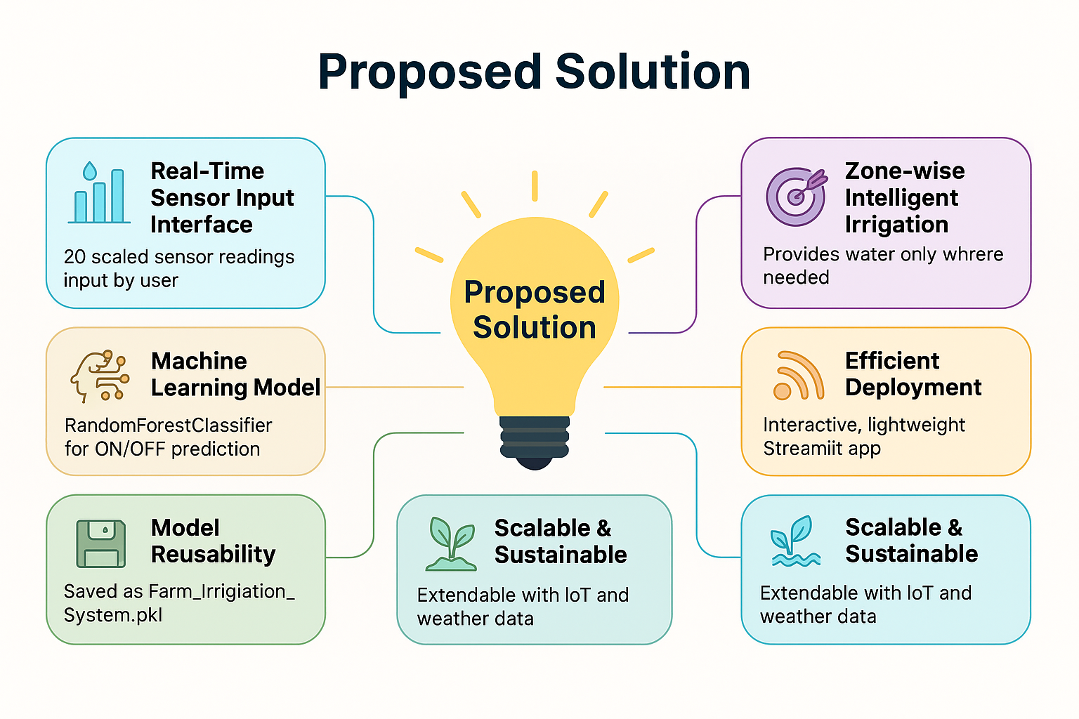

Slide 11
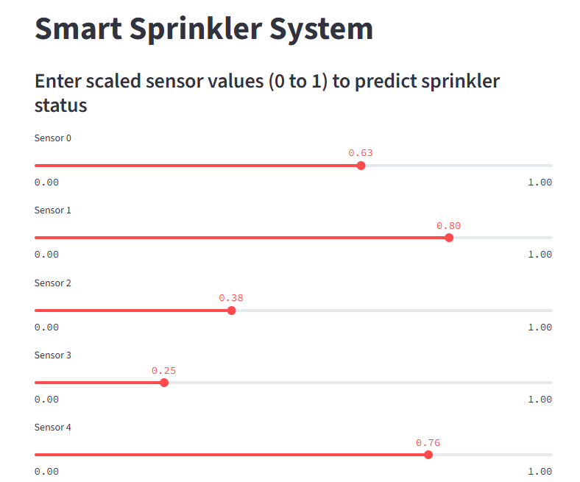
SCREENSHOT OF OUTPUT:

Slide 12
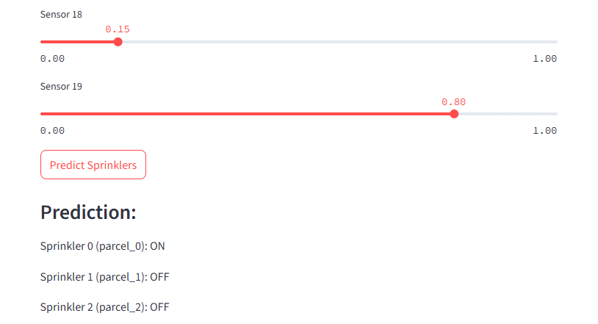
SCREENSHOT OF OUTPUT:

Slide 13
CONCLUSION:
The Smart Irrigation System project successfully demonstrates how Artificial Intelligence, when combined with real-time sensor data and user-friendly interfaces, can revolutionize modern agriculture.
Through this project, we:
🌾 Addressed the core issues of water wastage and inefficient irrigation.
🧠 Built a robust machine learning model using RandomForestClassifier for multi-output predictions.
🖥️ Deployed an interactive web application using Streamlit for real-time sprinkler control.
💾 Ensured scalability with model reusability using joblib.
🌟 Key Takeaways :-
💡 AI can enable zone-wise intelligent irrigation, ensuring precise water distribution.
💧 Smart irrigation saves time, labor, and valuable water resources.
🌱 The system improves crop health, yield, and promotes sustainable farming.

